Slide 1
Logging is Hot Again
Semantic logging, distributed systems, and more
Gaël Fraiteur
PostSharp Technologies Founder & Principal Engineer

Slide 2
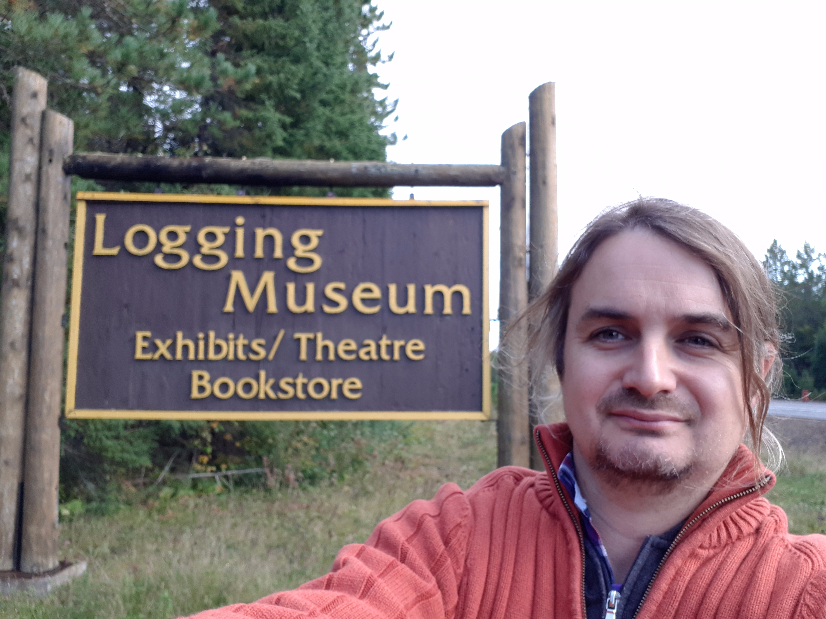

Slide 3

Source: https://cdnhistorybits.wordpress.com/2014/11/03/19th-century-lumberjacks-were-kinda-crazy/

Slide 4

About Me
Gael Fraiteur. Born in Belgium in 1978. First line of code aged 12. Living in Prague since 2001. Founder and CEO of PostSharp since 2004 – now a 9-people company. Dad of 5. Music lover.

Slide 5
About PostSharp
Since 2004.
Thousands of customers worldwide.
We help you eradicate repetitive code by automating design patterns.
15+ ready-made patterns.
Framework to implement your own patterns.
Typically 15% decrease of code size.

Slide 6
Two questions for today:
As an architect, how to choose a logging service for distributed systems?
As a developer, how to prepare your .NET application for distributed logging?

Slide 7
Agenda
Choosing a Logging Architecture
Automatic Code Instrumentation
Correlating Traces
Coping with Very Large Logs
Summary

Slide 8
Choosing a Logging Architecture

Slide 9
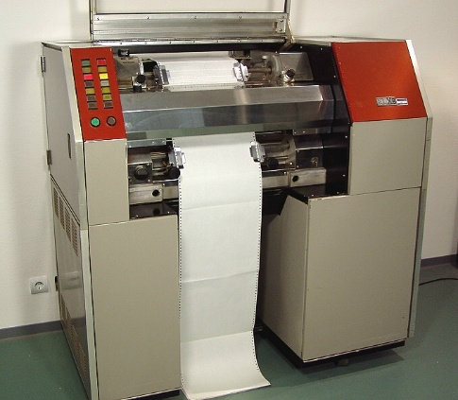
The origin of logging
Linear
Text-Based
Consumed by humans
http://www.technikum29.de/en/computer/punchcard
C:\> ECHO Hello > LPT1

Slide 10
Software Has Changed, So Has Logging
Before | Today
Single-threaded | Multi-threaded
Monolithic | Distributed
On-premise hosting | Cloud hosting
Simple || Expensive | Complex || Cheap
Monitored by humans | Monitored by machines

Slide 11
What do we expect from logging?
Role
Op
Performance Monitoring
Statistical Metrics
Application Performance Management
Dev
Defect Reproduction
High Details
Logging / Tracing
Objective
Needs
Solution

Slide 12
Dev/Op: Different Needs, Blurry Borders
Requirement | Dev | Op
Hardware Metrics: CPU, Disk, RAM, Network | No | Yes
OS & System Services Logs | No | Yes
Application Warnings & Errors | Yes | Yes
Detailed Application Logging | Yes | No
CLR Metrics: GC | Yes | No

Slide 13
A plethora of vendors
Azure
Splunk
DataDog
New Relic
Sematex
Scalyr
Dynatrace
Sysdig
Logz.io
Dynatracce
Elastic
Logentries
InfluxData
Sensu
Appneta
Logmatic.io
Lightstep
Instana
Seq

Slide 14

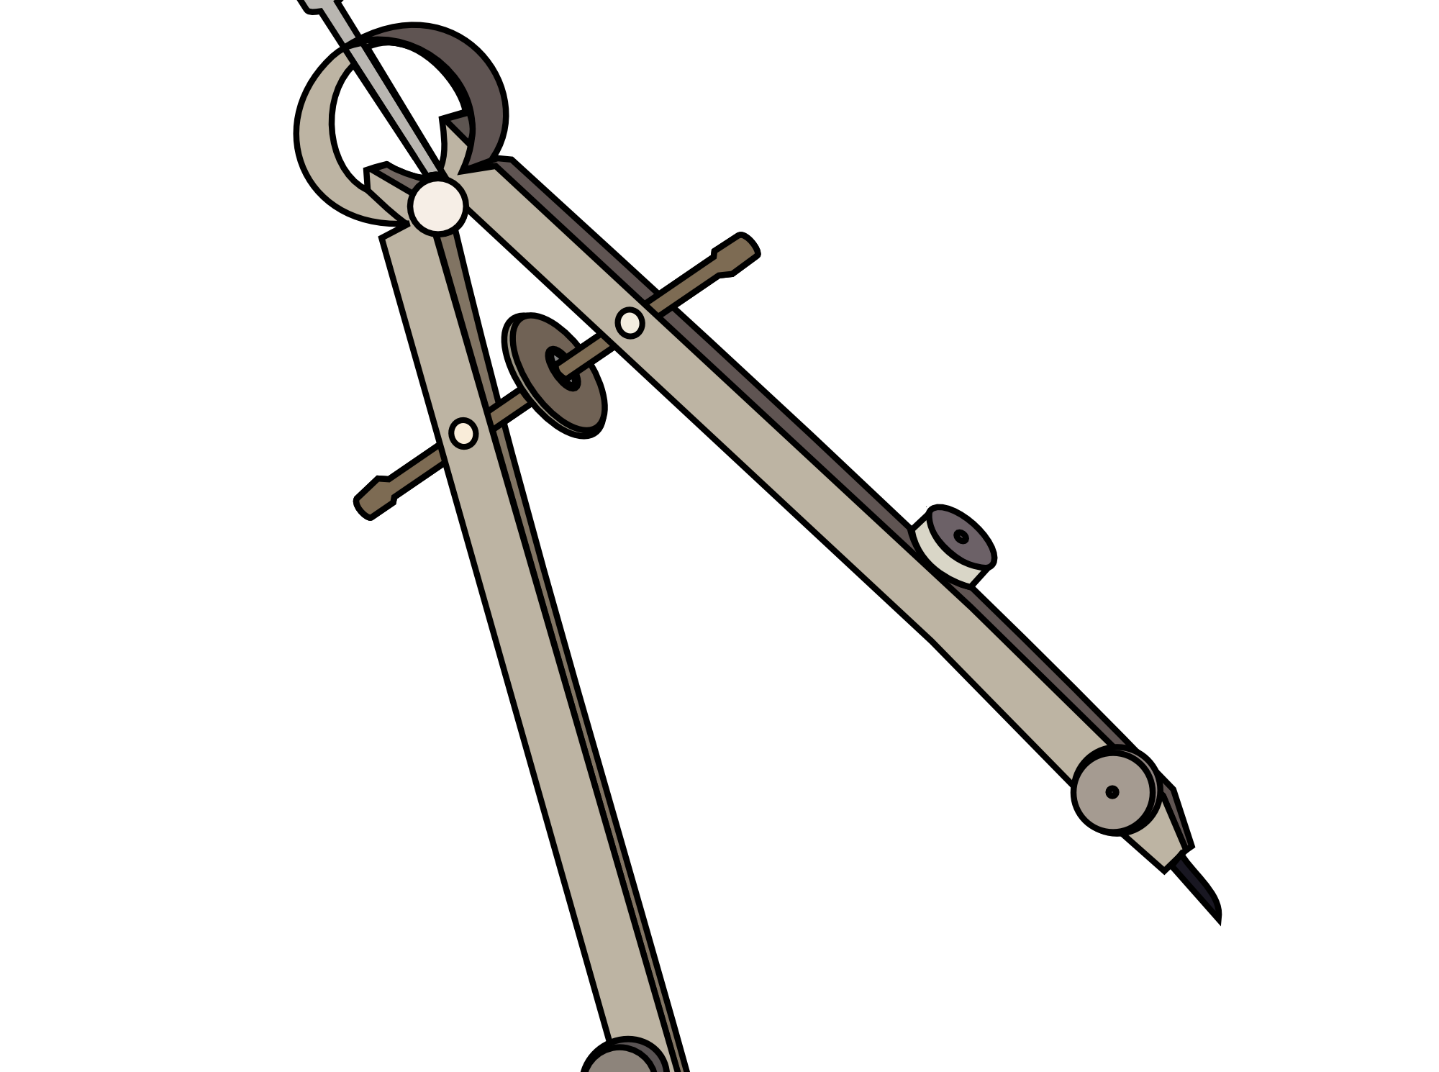

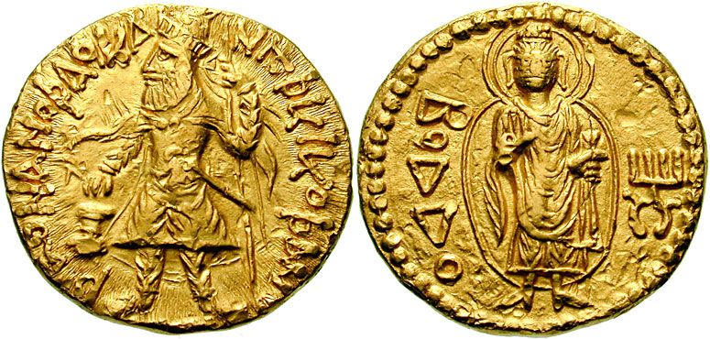
Buyer’s Wish List
What to look at when selecting a logging solution?
Operations
Development
Legal
Finance
Collects data for all systems I use?
Operating system, containers, databases, web servers, messaging, …
Has connectors for the languages I use?
.NET, .NET Core, Java, Ruby, Node.js, …
Collects logs, not just metrics?
Semantic logging, not just text?
Correlates distributed operations?
Data privacy law compliance
Data Export
Right to Delete
Cost per month for required volume and retention

Slide 15
Architecture of a logging solution
Data Sources
Applications
OS
Databases
HTTP
…
Data Shipping
Local Buffering
Data Ingestion
Format conversion
Live Data Store
Store
Index
Search API
Analysis
Dashboard
Search UI
Data Optimizer
Aggregate historical data
Archive unnecessary details.
Cold Data Store
Store
Alerting
Rule-based alters
Anomaly detection (AI)
Incident Management
Deduplication
Regression
Tickets

Slide 16
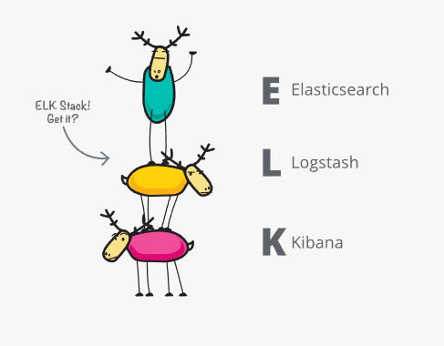
The Elastic Stack
Step | Elastic Stack
Data Shipping | Beats
Data Ingestion | Logstash
Live Data Store | Elasticsearch
Dashboard & Analysis | Kibana
Alerting | X-Pack
Data Optimizer
Cold Data Store
https://www.elastic.co/elk-stack

Slide 17
The Azure Stack
Dev: Azure Application Insights
Some automatic instrumentation
Serilog integration
Op: Azure Log Analytics aka Operations Insights
You install agents on VMs

Slide 18
Other Open-Source Software
Step | Other OSS
Data Shipping | Fluent bit
Data Ingestion | Fluentd
Live Data Store | Apache Sol; Prometeus; InfluxDB
Dashboard & Analysis | Grafana; Prometeus
Alerting | Prometeus; Nagios
Data Optimizer
Cold Data Store

Slide 19
LAB 1
Serilog + Elastic Stack
All credits go to https://github.com/FantasticFiasco/serilog-sinks-http-sample-elastic-stack

Slide 20
Correlating Traces

Slide 21
OpenTracing Standard
Defines concepts, terminology and API
Span = Activities,
Span References = Relationships (e.g. parent/child)
Tags = Named properties of a specific span
Baggage = Cross-process sticky key-value pairs

Slide 22
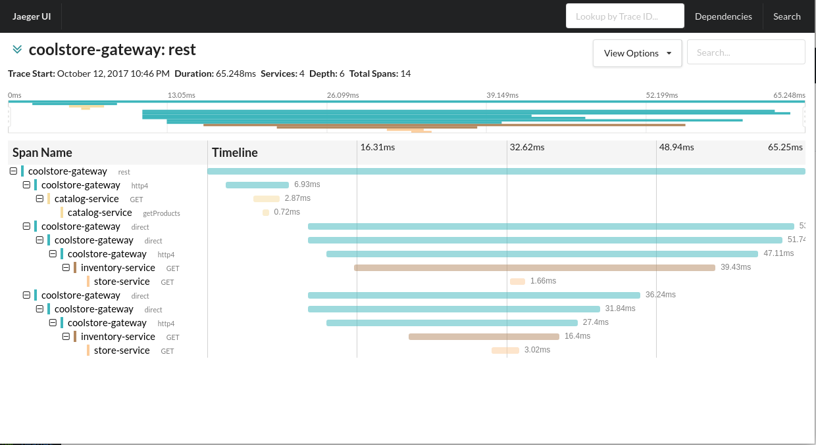
Flagship implementation: Jaeger

Slide 23
And in .NET?
You already know…
Enter…
System.Diagnostics.Trace
System.Diagnostics.TraceSource (added switches)
System.Diagnostics.EventSource (added semantic events, performance)
System.Diagnostics.CorrelationManager (added semantic events, performance)
Microsoft.Extensions.Logging.ILogger (added dependency injection)
System.Diagnostics.DiagnosticSource (adding hierarchical activities)

Slide 24
System.Diagnostics.DiagnosticsSource
Basically a .NET implementation of OpenTracing concepts
System.Diagnostics.Activity
Tags, Baggage
Hierarchical ID
System.Diagnostics.DiagnosticsListener
Most logging frameworks are not ready for hierarchical and distributed logging! (exception: Application Insights, which is not great for logging anyway)

Slide 25
DIY Correlation: Client-Side
Add an OperationId property to the logging context
Emit a record representing the dependency call
HttpClient: Add Resquest-Id header to the HTTP request
public void Process( Customer customer, Order order )
{
Guid operationId = Guid.NewGuid();
using (LogContext.PushProperty( "OperationId", operationId ))
{
this.logger.Information( "Invoking microservice to process order {@order}.", order );
this.httpClient.DefaultRequestHeaders.Remove( "Request-Id" );
this.httpClient.DefaultRequestHeaders.Add( "Request-Id", operationId.ToString() );
this.httpClient.PostAsJsonAsync( "https://localhost:44332/api/orders", order ).Wait();
}
}

Slide 26
DIY Correlation: Client-Side
Strategies to add the HTTP header
Change every use of HttpClient, or
Wrap HttpClient, or
Use the Activity + HttpHandlerDiagnosticListener, super-hack or
Use PostSharp to instrument HttpClient.

Slide 27
DIY Correlation: Server-Side
Action Filter: Read the Request-Id header
Set the ParentOperationId property (e.g. to Serilog LogContext)
public class LoggingActionFilter : IAsyncActionFilter
{
public async Task OnActionExecutionAsync( ActionExecutingContext context, ActionExecutionDelegate next )
{
string operationId = Guid.NewGuid().ToString();
string parentOperationId = context.HttpContext.Request.Headers["Request-Id"];
using (LogContext.PushProperty( “ParentOperationId", parentOperationId ))
using (LogContext.PushProperty( "OperationId", operationId ))
{
await next();
}
}
}

Slide 28
Choosing an Operation Id
Is GUID just not good enough?
Problems
Solution
Easily filtering all children activities?
Sort records emitted with non-synchronized clocks?
Hierarchical ids
Easy filtering using “string.StartsWith”
Alphanumerically sortable ids
Easy sorting using all query engines

Slide 29
LAB 2
Correlating Traces with Serilog

Slide 30
Automatic Code Instrumentation

Slide 31
Automatic or Manual? Both!
How to generate log records in your application.
Manual
Automatic
Meaningful & intentional
Key decision points
Low Volume
Very valuable
Labor-intensive
Often dumb
Start/End of Methods
High Volume
Lot of noise
Labor-free

Slide 32
Technologies for Automatic Logging
MSIL-level instrumentation
Or on-the-fly, by a monitoring agent (pay per server)
Or at build-time, like PostSharp Diagnostics
Action filters (ASP.NET MVC), Behaviors (WCF)
Dynamic Proxies (Dependency Injection frameworks)

Slide 33
LAB 3
PostSharp Diagnostics

Slide 34
Attention to privacy/security leaks!
It’s too easy to log sensitive data.
Use opt-out mechanisms (e.g. [NotLogged] in PostSharp)
Testing strategy:
Invoke system with well-known sensitive input data, e.g. password = Password1234#.
Test that the well-known strings are not in logs.
Verify the output log, or
Use a custom, assertion-checking trace listener.

Slide 35
Visualizing Async Traces

Slide 36
LAB 3
PostSharp “Frigate”

Slide 37
Coping With Very Large Logs

Slide 38
Semantic Tracing: preparing for statistical processing
DO NOT write unstructured text logs
e.g. Retrieving account 152
DO NOT write unnamed structured logs
e.g. Retrieving account {AcountId:152}
DO write structured logs with named messages
e.g. Message:GetAccount, AccountId:152
e.g. GetAccount(152)
→ Make bucketing easier

Slide 39
LAB 4
Drilling Down Semantic Logs

Slide 40
Optimize Performance for Disabled Logger
Verbose logging sources are most likely to be disabled.
Make a disabled logging statement has minimal impact.
Use the Elvis (?.) operator
static readonly ILogger logger = LoggerFactory.GetEnabledOrNull();
logger?.Write( “MyRecord”, new { Id = id } );

Slide 41
Sampled Tracing of Requests
No need to detail-trace 1,000 requests/sec.
The more frequent a request is executed, the less likely you trace it
Strategies:
constant number of traced requests per second and per request type
AsyncLocal<ILogger> logger = ...
logger.Value?.Write(…);

Slide 42
LAB 5
Elvis and Sampled Logging

Slide 43
Summary

Slide 44
Summary
Logging is Changing.
Emerging standards and APIs, but not mature yet.
Serilog, NLog, … are missing first-class support for:
Hierarchical activities
Semantic-first tracing
DYI techniques:
Correlation
Efficient bucketing (semantic-first)
High-performance
Sampled tracing
Don’t write too much boilerplate :)

